Slide 1

UC High Powered Rocketry
Kick-Off Meeting
Nov 28th

Slide 2
Agenda
Introductions
Review your organization's information
Discuss a UC-wide High Power Rocketry email list
Solicit feedback for an in-person meeting

Slide 3
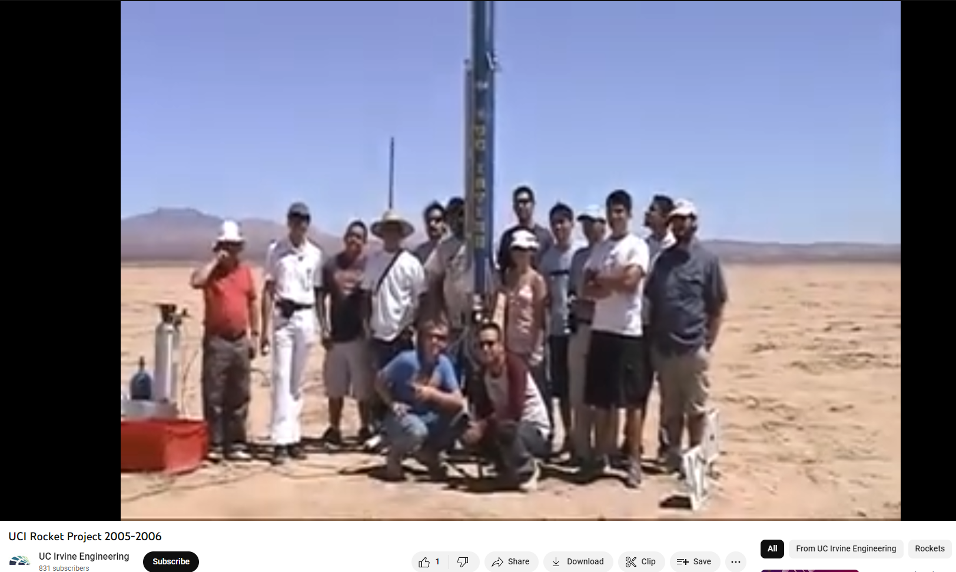

Introductions
Name, Group, Campus
https://youtu.be/64ahKJdSSjM?feature=shared

Slide 4
Background
Student-led Rocketry clubs have become significantly more advanced
Increased opportunities for
Rocket fabrication
Motor fabrication – liquid and solid propellants
Competitions and launch sites in harsh environments
No Major Incidents
Near-misses reported in 2nd hand accounts and posted recordings
Blindspots for the University
No consensus for management/support for Registered Student Organizations
Lack of awareness of activities – both on and off-campsu

Slide 5
Goals
Build communication and trust with student organizations
Develop a safety culture
Open lines of communication and support
Support student growth and learning
Help UC Staff understand how to best support rocketry safety hazards

Slide 6

High-Level Plan
Identify Gaps in Visibility
Convene Student Orgs
Discuss Recurring Support
Engage Stakeholders
Identify Short-Term Support Needs
Develop Long-Term Plan
Monitor Short-Term Results

Slide 7
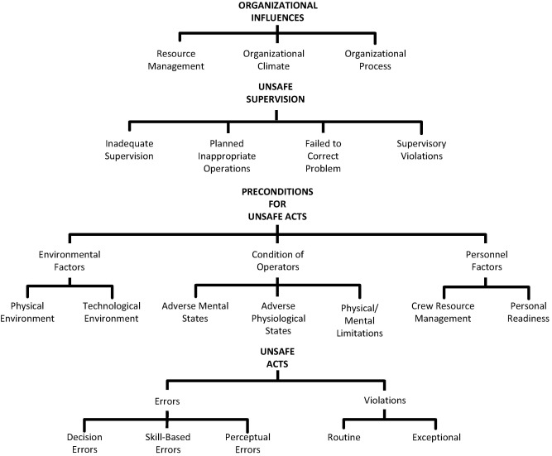
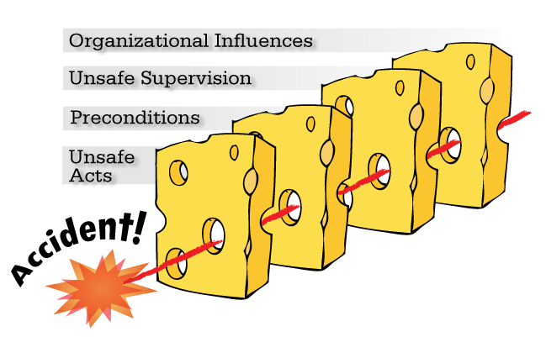

System Safety

Slide 8
Non-Punitive Reporting Policy
The Non-Punitive Reporting policy promotes a culture where everyone can self-report on unintentional errors and near misses experienced in their workplace.
When reporting such an occurrence, you will not be subjected to disciplinary measures so long as you are self-reporting in good faith, and have not engaged in criminal activity or gross-negligence.
We encourage you to self-report occurrences, as the root causes and lessons learned can help improve safety for your fellow students.
Everyone is responsible for their own actions and has the ability to self-report occurrences without risk of discipline.

Slide 9
Learning about our Rocketry Groups – 50Qs
Group Name
Website
Email
President
RSO/DSO/Dept
Members
Group Goal
Projects
Sole Occupant workspace on Campus
Shared Assigned workspace on Campus
Utilize Existing Campus Facilities
Sole Occupant Workspaces at other UC property
Shared Assigned Workspaces on UC Property
Any Workspaces on 3rd Party
Group Vehicles
Assembly (Hand tools) in Assigned Workspaces
Machine Work (cutting, drilling, grinding, sanding, welding) in Assigned Workspaces
Fiberglass/resin Layout in Assigned Workspaces
Cold flow testing on Campus
Soldering in Assigned Workspaces
3D Printing in Assigned Workspaces
Hazardous Material Storage in Assigned Workspaces
Black Powder (on campus storage)
Solid Motors/Fuel Grains (on campus storage)
New Member Safety Onboarding
Quarter/Year-long Formal one-on-one Mentorship System
UCLC/EHS Safety Training
3rd Party Training
Waiver and Release of Liability
# of Active Rockets to Launch this year
# Solid Propellant (single stage)
# Solid Propellant (multi-stage)
# Bipropellant
# Hybrid Propellant
# of Active Engines in Dev (static) this year
Bipropellant
Hybrid Propellant
Type of Solid Fuels
Type of Liquid Fuel
Type of Oxidizer
Other Types of Liquid/Gas
Fuel Storage On Campus
Fuel Transportation
Fuel at Launch
Launch Sites
Transportation – car/van/rental
Estimated # of Launches/Yr
Estimated # of Static Fires/Yr
Travel to National/International Competition

Slide 10
Action Item: Review Data
https://ucdrones-research.github.io/rocketry/
Question 1: Is your data accurate?
Question 2: Are there questions that I should be asking but didn’t?
What pieces of information should your campus know about your group?
Due: December 19

Slide 11
Communication
Name | Campus | Contact
Space Enterprise (SEB) | UC Berkeley | info@seb.berkeley.edu
Space Technologies and Rocketry (STAR) | UC Berkeley | ucberkeleystar@gmail.com
Aggie Propulsion Rocketry Lap | UC Davis | aprl@ucdavis.edu
Rocket Project UCI | UC Irvine | ucirocketprojectteam@gmail.com
Rocket Project UCLA | UCLA | rocketproject@ucla.edu
Rockets Academy – AIAA | UC Merced | aiaa@ucmerced.edu
Highlander Space Program | UC Riverside | highlanderspaceprogram@gmail.com
Rocket Team | UC Santa Cruz
Students for the Exploration and Development of Space (SEDS) | UC San Diego | Seds.ucsd@gmail.com
Rocket Propulsion Lab at UCSD | UC San Diego | rocket@ucsd.edu

Slide 12
Action Item: Systemwide Rocketry Email List
Would you like an email listserv for high-powered rocketry?
Possible Values
Share information or ask for help
Coordinate FAR trips
Promote your milestones
UCOP/myself will be monitoring and can help answer questions
Add whomever you want

Slide 13
In-Person Meeting
We would like to host an in-person UC High Power Rocketry Summit at UC Irvine
We will fund two (2) members from each organization - including airfare, two hotel nights, and food.
1.5 days of meeting time
We will also have some funds available to help support safety gear

Slide 14
In-Person Meeting - Agenda
Introductions
UC EH&S Team
Organization Briefs
High Power Rocketry Safety
Data Review
Safety Trends and Issues
Working with Campus Leadership
Round Table Discussions
Improving Safety, Training and Communication
Breakout Discussions
Safety gear, mission support, tools and metrics of success
Next Steps

Slide 15
Action Items: Answer Survey
Which would you prefer?
Monday 9am – Tuesday 1pm
Thursday 9 am – Friday 1pm
Thursday 1pm – Friday 5pm
Best Month
February
March
April
We will fund two (2) members from each organization - including airfare, two hotel nights, and food.

Slide 16
In-Person Meeting - Agenda
What are your most important goals for an in-person meeting?
Are there other items you would like to see in the agenda?
Introductions
UC EH&S Team
Organization Briefs
High Power Rocketry Safety
Data Review
Safety Trends and Issues
Working with Campus Leadership
Round Table Discussions
Improving Safety, Training and Communication
Breakout Discussions
Safety gear, mission support, tools and metrics of success
Next Steps

Slide 17
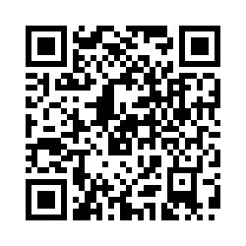
Open Forum
Anything you would like to hear or learn about?
Anything we can do to help support?
QR Code for Survey
Notes:
https://ucmerced.az1.qualtrics.com/jfe/form/SV_8DjgBRVXP2FaHL8

